Slide 1

Power Pong

Slide 2
Project Description

Slide 3
Story and concept based on, and algorithm and gameplay based on
Story—(story based on)
Concept
The basic concept of the game came from the sport table tennis which was then developed into an electronic game “Pong” by the American game manufacturer Atari, Inc. in 1972.
The original game consisted of two paddles that players used to volley a small ball back and forth across a screen.

Slide 4
Gameplay basis
The gameplay is based on the original Pong game but with added features of upgrading some attributes of the pong. An arcade game with frame based animation that is being refreshed every mi

Slide 5
Gameplay

Slide 6
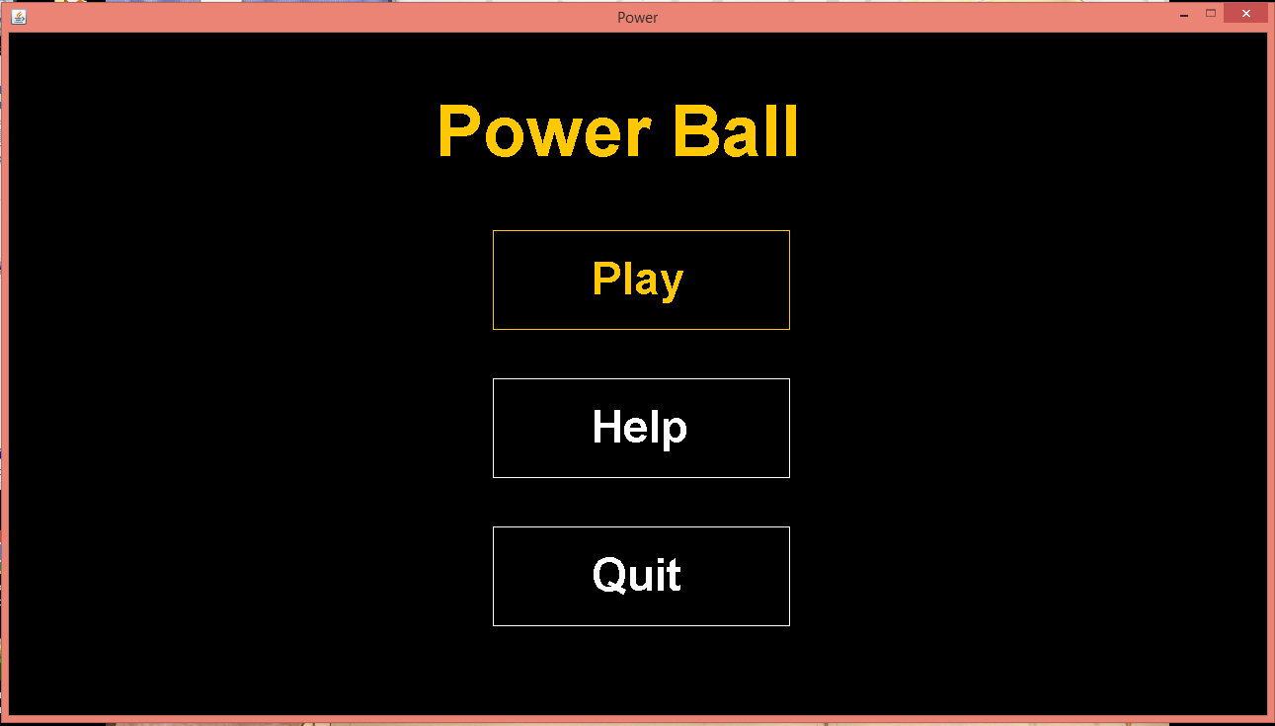
Gameplay
1. Hit enter to start game
2. Select to show other instructions
3. Select to quit the game

Slide 7
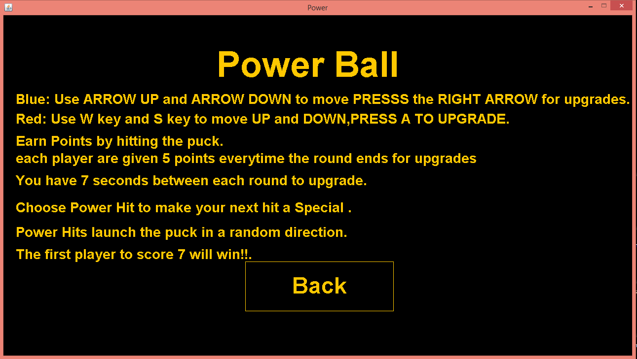
Shows some basic mechanics of the game.

Slide 8
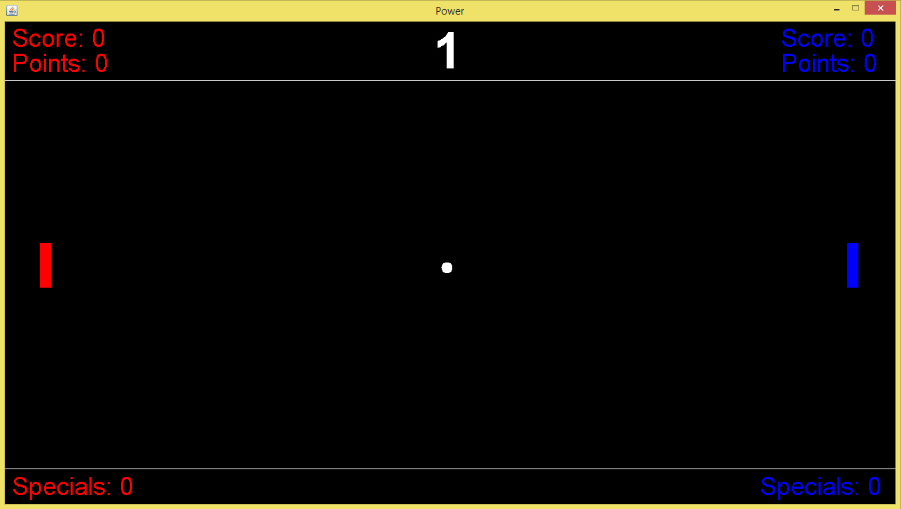
The main goal of the game is to hit the ball and let it pass through behind the opponent.
Each ball that passes through behind the opponent’s ‘pong’ can give you 1 score.
The first player to reach the score of 7 is the winner.

Slide 9
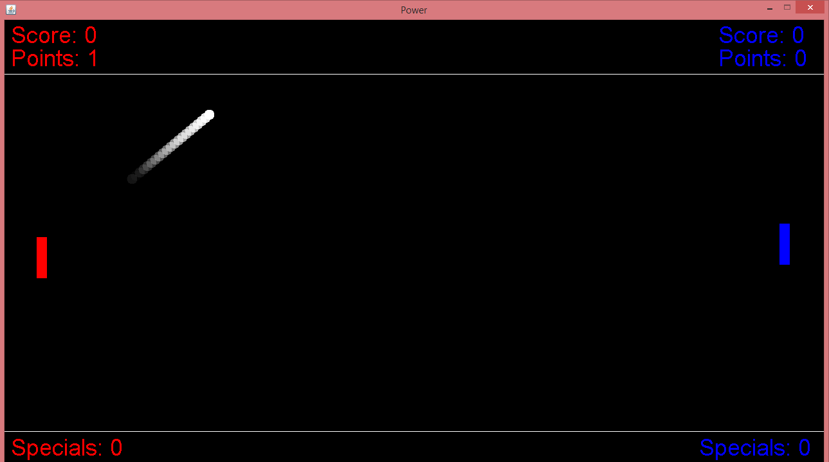
Each hit of the ball can let you earn 1 point.
Points can be used to upgrade your ‘pong’.
Losers of each round earns 5 points.

Slide 10
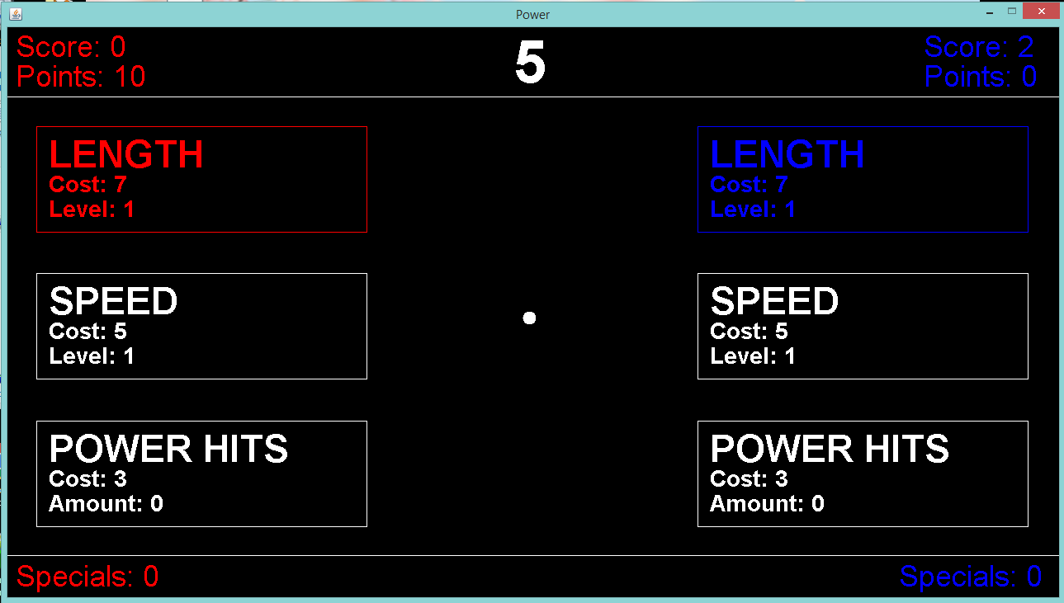
Points are used to upgrade your pong.
Cost -is the total number of points needed for upgrade.
Level -indicates how many times you upgraded an attribute.
Amount – number of times you can use power hit.

Slide 11
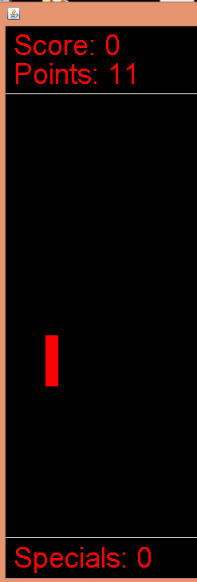

Upgrading length increases length of ‘pong’
Upgrading speed increases movement speed of ‘pong’
Buying Specials increase amount of special attacks

Slide 12
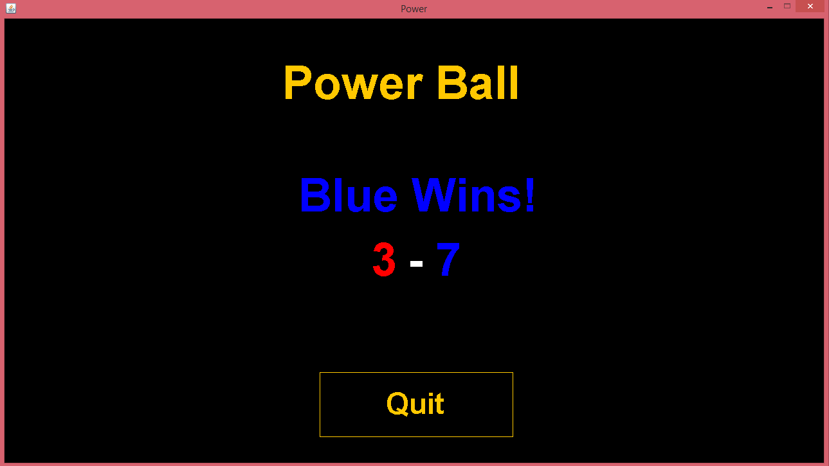
First player to reach a score of 7 is declared as the winner.

Slide 13
Resources
Online sources:
https://www.Britannica.com/topic/Pong

